Slide 1
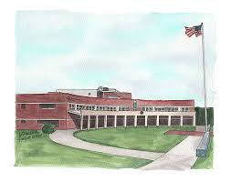
H&S Bn, HQMC Henderson Hall Back in the Saddle 2021
Make the right decisions! Your family, your leadership, and fellow Marines are counting on it!

Slide 2
Summary of Virtual Events
CO kickoff message
Henderson Hall Director of Safety
  Guidance and updates
  Marine Corps Safety Management System
  Force Preservation / CIRRAS Deployment
Henderson Hall Chaplin Suicide Awareness
Henderson Hall Substance Abuse Team

Slide 3
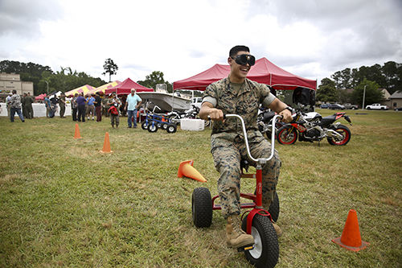
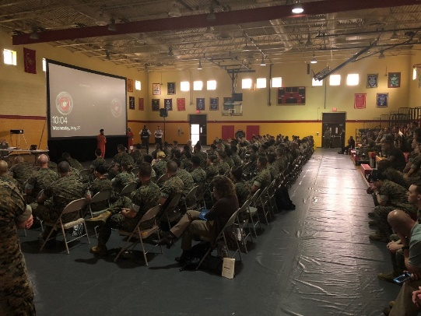

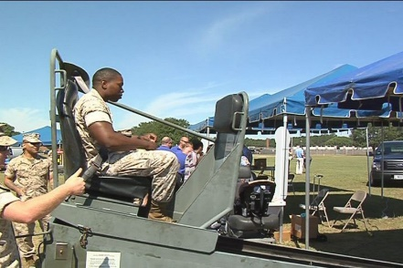
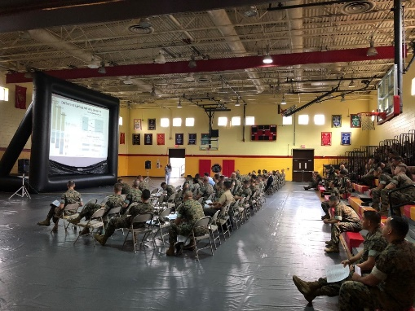
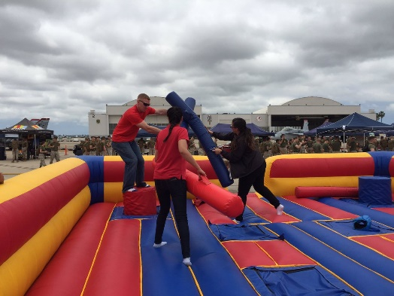
Operational Pauses
BLUF: Time to reset and prepare for the next year!
Historically, the Marine Corps and other DOD agencies take this time to reset upon
returning from the winter holiday, these efforts refocused training and operations
requirements and allows leaders to advise all personnel, military and civilian, to focus
on professionalism, policies, procedures, processes, and safe operations.
The purpose of BITS training is to provide a reorientation period for all personnel. An
effective bits training event is critical to ensure our Marines, Sailors, and civilians remain
focused on their responsibilities after the holiday break, and prepare themselves
to any upcoming challenges they will face in the new year.
The current COVID-19 challenges we face are unprecedented. These training
pauses allow us is dissect our recovery plans and implement additional
mitigation stratagies that will further protect our Marines, civilians, families
and friends while adhering to DOD, USMC and State guidelines.
As we move closer to spring, keep in mind, when travel bans begin to
lift, all must remain aware of their surroundings. Avoid large groups, and
do not touch your face. Avoid high-touch areas that have been touched
by many others. Wash hands thoroughly (for 20 seconds) and often.
Wear a mask when in public locations and remain at least six-feet from
others, and where required (such as on DoD installations.)

Slide 4
Overview
Your Safety Office - Overview
Safety Resources
Marine Corps Safety Management System (MCSMS)
Reorganization of our Motorcycle Club
Web Application
  - Updates
Safety Repeats
Force Preservation - CIRRAS Tool - Wave-top

Slide 5
Safety “360 Degree Awareness”
To provide Marines, Sailors, Civilians and their families assigned to Henderson Hall with Ground Safety, Occupational Safety and Environmental Protection Programs and Services.
  BLUF - The Command Safety Office is your _end state_ for all safety requirements and programs.
  Commands Safety Culture – 360 Degree Awareness - Families included!
Training
  Back in the Saddle (BITS) 101 Days of Summer Stand downs
  Load Lifting Equipment Programs, USR, OSHA 10 and 30 hour (Certification course)
  Risk Management Training (Biennial – every two years)
Mishap Reporting
  Report all mishaps and near misses – Light duty injuries included (There is no repercussions)
  Company Office/s is your Liaison for reporting mishaps
  Supervisors Mishap and Near Miss Reporting form
  Include Safety in all PCRs.
Promotional Materials.
  National Safety Councils Family Safety and Health Magazine: Disseminated throughout the command to include the Pentagon. Web link is also available (Weekly Gouge – Command Web App)
  Quick Books, “Safety Checks” new letters, training power points
Motorcycle Safety Program
  Henderson Hall Motorcycle – All Riders who own a motorcycle will participate i.e. meetings, events etc. Club Rides are not mandatory Provide all information to the Club representatives i.e. license, insurance, training etc.
  Attend required training: ESAMS, (MCBQ, Ft Belvoir, Anacostia
Notes:
MCICOM has their own internal safety Office at the HQ
HQMC Civilians will utilize your local Unit Safety Representative

Slide 6
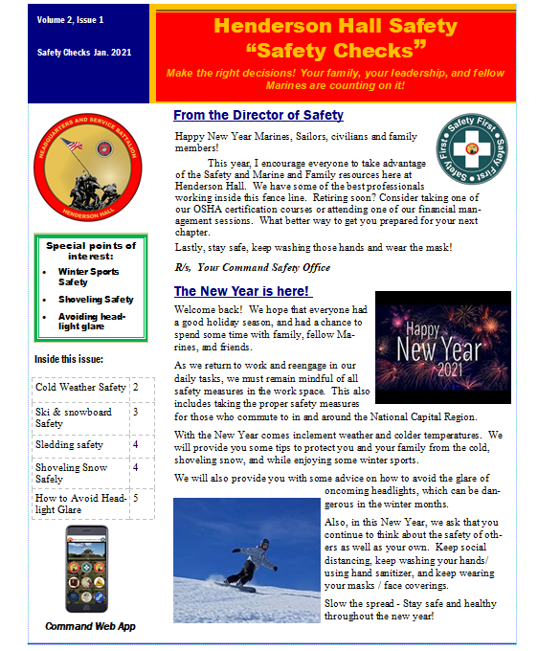
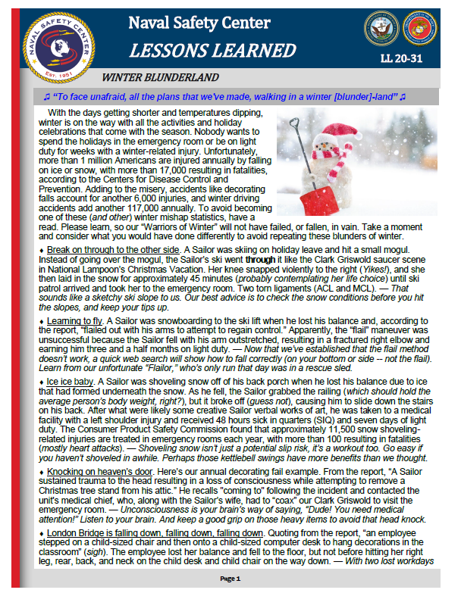


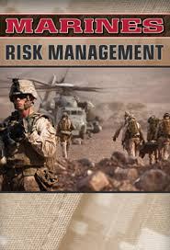

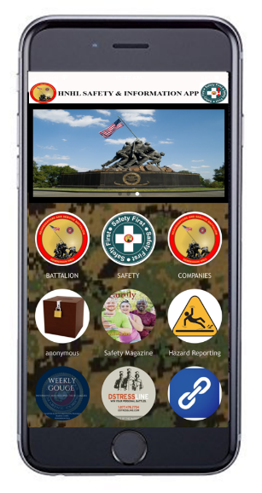

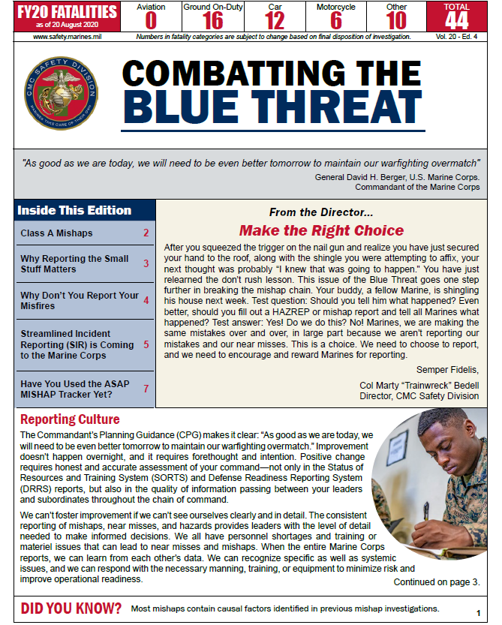
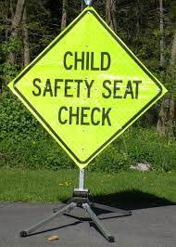

Safety Resources
Command Web App

Slide 7
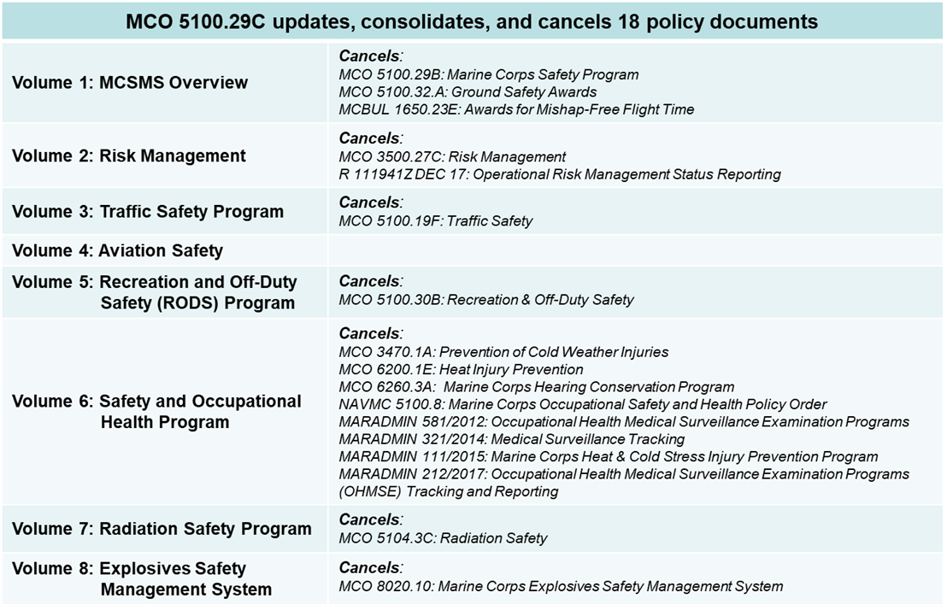
Marine Corps Safety Management System (MCSMS)
The Marine Corps Safety Management System (MCSMS) provides a framework for redefining safety in terms of risk management, and refocusing safety on achieving operational excellence. Specifically, “safety” becomes the execution of the discrete tasks associated with the Risk Management process: identifying hazards, assessing risks, and implementing controls. This systems approach moves beyond the legacy focus on preventing mishaps by refocusing on the application of high standards, attaining operational excellence, and improving readiness.
Marine Corps Safety Management System and cancels the legacy Safety Program. The Order consists of a Base Order and five Volumes: Volume 1 Marine Corps Safety Management System Overview, Volume 2 Risk Management, Volume 3 Marine Corps Traffic Safety Program, Volume 4 Marine Corps Aviation Safety, and Volume 5 Recreation and Off-Duty Safety (RODS) Program. Three additional volumes will be added in FY 2021, Volume 6 Safety and Occupational Health Program, Volume 7: Marine Corps Radiation Safety Program, and Volume 8: Marine Corps Explosives Safety Management Program.

Slide 8
MCSMS Overview
Recent Executive Safety Board (ESB) Discussion
Just Culture. The foundation for a functioning safety management system and a healthy safety culture is the establishment of a just vice a punitive culture. In a just culture, when leaders become aware of a hazard, near miss or mistake they should focus on “what happened and why” vice “culpability and punishment.” A just culture fosters partnerships, builds trust between team members, and encourages the identification of hazards, near miss events, and mistakes. A just culture requires reporting without fear of reprisal or adverse action. A just culture is not possible when leaders do not allow mistakes or apply a zero defect mentality.
Four Pillars. The management system is organized using four distinct pillars: Policy and Leadership, Risk Management, Safety Assurance, and Safety Promotions and Training. Commanders at all levels shall create their own SMS that accounts for their assigned mission and geographic location.

Slide 9
MCSMS cont. “Pillars Broken Down”
(Pillar 1) Policy and Leadership. Operational safety policy defines the processes and organizational structure needed to meet both readiness and capability goals. Visible senior leader advocacy for the universal application of risk management reinforces commitment to meeting identified standards. Relevant policy matched with enthusiastic leader engagement underpins the reporting culture required to improve readiness and prevent mishaps.
(Pillar 2) Risk Management. All leaders must continuously communicate the importance of consistently applying Risk Management. Leaders must embed the Risk Management process (identify hazards, assess risks, implement controls) into day-to-day operations, deliberate planning processes, and warfighting.
(Pillar 3) Safety Assurance. Evaluations and inspections provide commanders verification that the key elements of the MCSMS are functioning, and guide continuous improvement efforts. Management of the system requires measuring key metrics of the system’s performance.
(Pillar 4) Safety Promotions and Training. The communication of lessons learned and case studies, training, and other actions create a positive safety culture learned and case studies, training, and other actions create a positive safety culture across all echelons of Marine Corps organizations and activities.

Slide 10
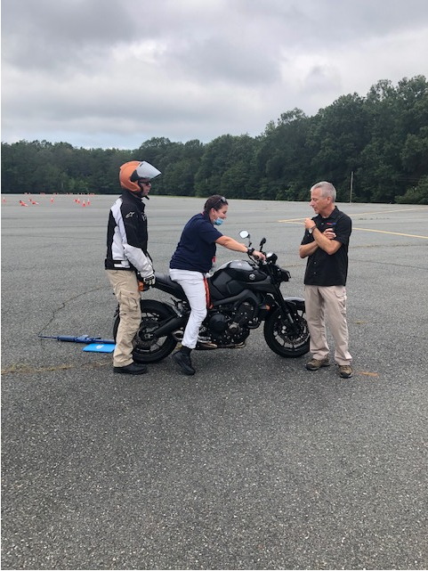
Reorganization of our Motorcycle Club
  Henderson Hall Motorcycle Club
    - Distribution
  Check in process
  Training requirements “Not trying to make you miserable”
    MCO 5100.29C Vol. 3 Traffic Safety
    Licensed riders and Basic Riders Course (BRC) 180 days to record
    3yr now 5yr recertification
    PPE - Fingerless gloves (Army still requires full finger)
  Training opportunities
    - ESAMS, NCR Training locations
  Recent Beta testing
    - CMC SD and MCICOM Host
  - Sept 11 2020 at MCB Quantico (Camp Upshur)
  - Champions Riding School
  Look at the opportunity instead of the requirement!

Slide 11
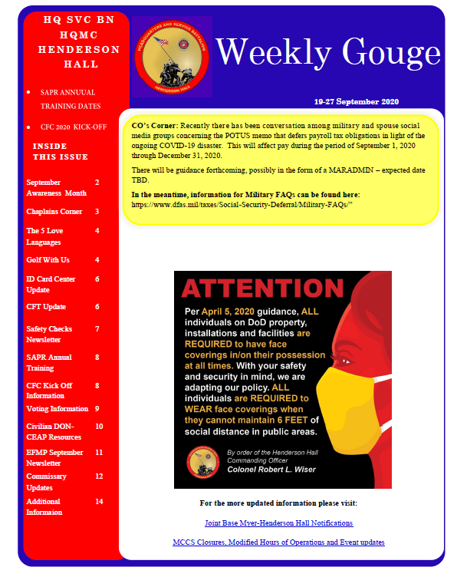
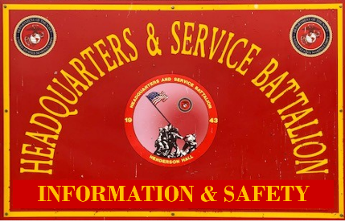
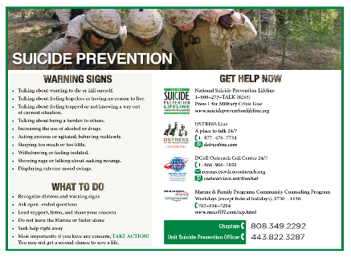
Web Application Updates
Created and tailored to provide a “one stop shop” for all Marines and their families who
are ADCON to Henderson Hall.
Approved application
All public knowledge.
Increase safety awareness involvement.
Increase in hazard reporting.
Provide
Not just Safety
  Weekly Gouge
  Bn and Company Icons – information
  Marine and Family Services
  Help / DStress Line
  Quick links
    HH Facebook
    HH Twitter
    Lyft/Uber
    WTOP news
    OPM

Slide 12
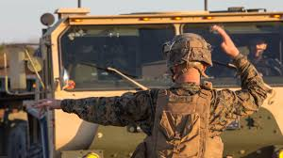
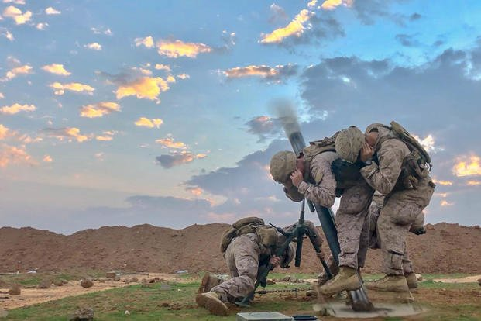
Safety Repeats
Hearing Readiness
  Audiograms are an annual requirement
  Effect medical readiness
  Medical Readiness Reporting System
  Short falls
Drivers improvement
  Marines under 26
  4 hr. requirement
  Online - MarineNet

Slide 13
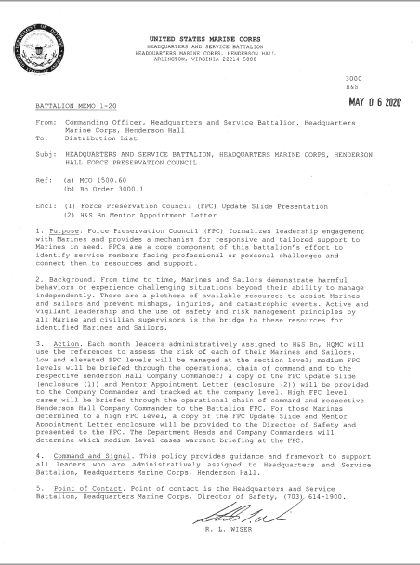
Force Preservation
MCO 1500.60 Unit Force Preservation Councils (FPC)
Every Marine should have an assigned risk level and assigned a Mentor
Monthly, discussions need to be happening at the every level. Sections formalized your process
HH SOP provides the formal process
Every 3rd Thursday of the month.
Elevate / guidance from your Company Commanders
One page memo (6 May 2020)
Henderson Hall resources
BL - it’s about taking care of Marines!

Slide 14
CIRRAS Wave-Top
Force Preservation Council are a key component of taking care of Marines!
CIRRAS DOES NOT change the current FPC process!
CIRRAS is simply a FPC tool in support of the FPC, much like APES supports the PES
Command Individual Risk and Resiliency Assessment System (CIRRAS) is a secure encrypted web-based system that supports the exiting Marine Corps Force Preservation Council (FPC) process.
Mission Statement: Provide Commanders a single, standardized software based tool to enable proactive identification and assessment of individual risk and resiliency factors and the transfer of the same between commands in order to optimize individual/unit readiness and facilitate enterprise-wide risk management.
CIRRAS enables the United States Marine Corps (USMC) Commanding Officers (COs) and Senior Enlisted Advisors (SEA) to make informed and timely decisions on FP Risk Assessments based on the identification and tracking of individual SM behaviors and critical stressors associated with increased risk or resiliency as defined by the Commandant's "Six Fs” below as well as a “Critical Stressors” category for the most immediate concerns: sting Marine Corps Force Preservation Council (FPC) process.
  1. Fidelity 2. Fighter 3. Fitness 4. Family 5. Finances 6. Future 7. Critical Stressors
Henderson Hall is in the beginning stages of incorporating CIRRAS into the Bn FPC process.
Additional Information - Marine & Family Programs (MF) Division

Slide 15
Make the right decisions!
Your family, your leadership, and fellow Marines are counting on it!
Your Henderson Hall Safety Office

